Slide 1
Employee Performance Analysis Using Excel
PRESENTED BY: PARTHIPAN S
REGISTER NO.: 312204502
DEPARTMENT: COMMERCE
COLLEGE: K.C.S KASI NADAR COLLEGE OF ARTS AND SCIENCE

Slide 2
PROJECT TITLE
Employee Performance Analysis Using Excel

Slide 3
AGENDA
1.Problem Statement
2. Project Overview
3.End Users
4.Our Solution and Proposition
5. Dataset Description
6. Modelling Approach
7. Results and Discussion
8.Conclusion

Slide 4
PROBLEM STATEMENT
OVERREPRESENTATION OF LABORERS: There are three employees assigned the job function "Laborer," which is more than any other role. This might indicate that the workforce is skewed towards more manual or entry-level jobs.
UNDERREPRESENTATION OF CRITICAL ROLES: There is only one employee each for crucial roles like "Technician," "Engineer," "Foreman," and "Administrative." These roles often require specialized skills and are vital for the operations, so having only one person in each of these positions might create bottlenecks or dependencies on single individuals.
POSSIBLE GAPS IN MANAGEMENT: If there are no additional management or supervisory roles (besides "Foreman"), it might suggest a lack of leadership structure to oversee labor or technician tasks.

Slide 5
PROJECT OVERVIEW
[Workforce Analysis and Optimization]
The aim of this project is to analyze the current workforce distribution across job functions, identify any imbalances or inefficiencies, and recommend strategies for optimizing workforce allocation. The goal is to ensure the organization has the right mix of employees in both technical and administrative roles to improve operational efficiency
Data Collection
Data Analysis
Visualization
Training and Upskilling
Implementation Plan
Challenges and Risks

Slide 6
WHO ARE THE END USERS?
Human Resources (HR) Department
Department Managers (Sales & Production)
Senior Leadership/Executives
Employees
Finance/Compensation Teams

Slide 7
OUR SOLUTION AND ITS VALUE PROPOSITION
Filtering - Remove missing values.
Conditional Formatting - Blanks, Background Color Shading, Data Bars, Values.
Data Filtering and Sorting - Identify specific employee groups, such as those with exceeds, needs improvements and fully meets.
Pivot table - Summary of employee performance under their current rating .
Graphs - FINAL REPORT.

Slide 8
DATASET DESCRIPTION
EMPLOYEE ID: Unique identifier for each employee in the organization.
FIRST NAME: The first name of the employee.
DEPARTMENT TYPE: The broader category or type of department the employee's work is associated with.
JOB FUNCTION: A brief description of the employee's primary job function or role.
CURRENT EMPLOYEE RATING: The current rating or evaluation of the employee's overall performance.

Slide 9
MODELLING
DATA SET: Kaggle, Employee dataset.
FEATURE SELECTION: Slicer, Conditional Formatting, Designing.
DATA CLEANING: Missing values, Irrelevant data, Correct Errors, Remove Unnecessary Columns and Rows.
PIVOT TABLE: Employee ID, First Name, Department Type, Job Function, Current Employee Rating.
CHART: Report of Employee Performance based on their Employee Id is represent in Values and Performance Score presented as Column Chart.

Slide 10


RESULTS

Slide 11
CONCLUSION
[WORKFORCE DISTRIBUTION CHART]
The pivot chart highlights a significant imbalance in the workforce distribution across job functions. The most notable observation is the overrepresentation of "Laborers" with three employees, whereas other critical roles like "Technician," "Engineer," "Administrative," and "Foreman" have only one employee each.
This suggests:
1.Understaffing in Specialized Roles
2.Overrepresentation of Laborers
To maintain operational stability, improve productivity, and mitigate risk, the organization should consider redistributing resources by increasing headcount in specialized roles and balancing the labor force appropriately. This would result in a more efficient workforce, better equipped to meet the organization's technical and administrative demands.

Slide 12
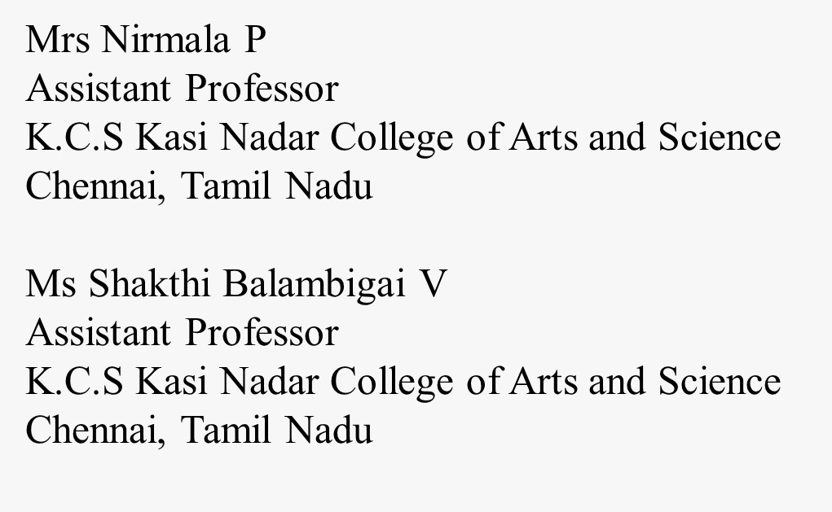
REFERENCE

